Slide 1
Assignment 3 Analysis
United We Stand:
Sunny Patel (40075684)
Zlata Korotkova (40051921)

Slide 2
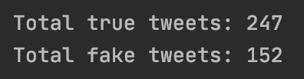
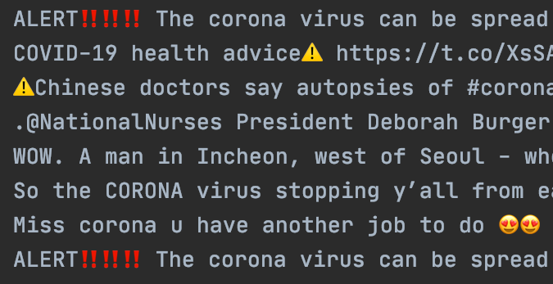
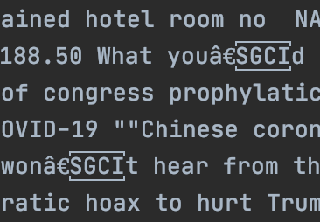
Initial Dataset
Training Set:
399 instances
Unbalanced
Symbols

Slide 3
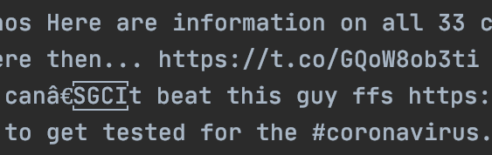
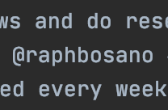
Initial Dataset
Test Set:
54 instances
Symbols

Slide 4
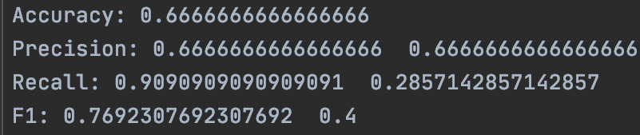
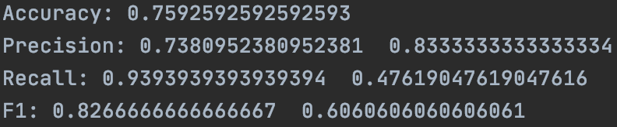
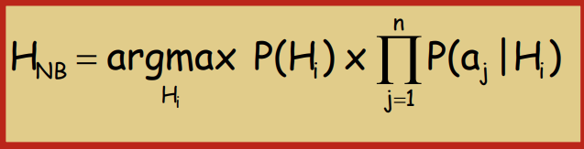
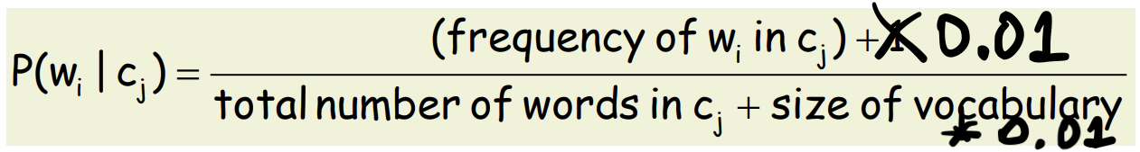

Models’ Vocabulary
NB-BOW-OV:
4314 words
Worse performance
NB-BOW-FV:
1193 words
No unnecessary words (overfitting)

Slide 5
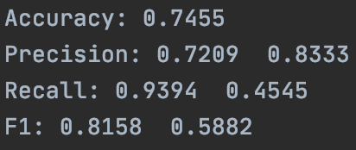
Results of All 3 Models
NB-BOW-OV:
NB-BOW-FV:
LSTM:

Slide 6
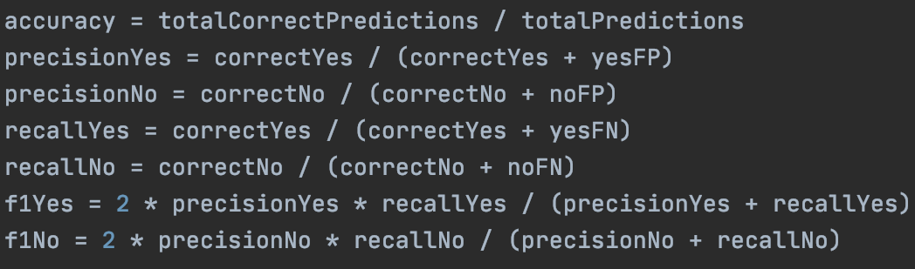
Results of All 3 Models
Unbalanced training dataset
Recall: we don’t want to label fake tweets as factual
Best performing model: NB-BOW-FV
Worst performing model: NB-BOW-OV

Slide 7
Responsibilities
Sunny Patel:
NB-BOW-OV
NB-BOW-FV
Trace files
Zlata Korotkova:
Evaluation files
LSTM
Presentation

Slide 8
Thank You! :)

